Slide 1
Cornerstone City Church Peninsula Plus Community Hoo Are Ya
29th June 2025

Slide 2
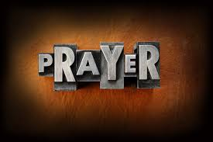

Slide 3
Thanksgiving
CCLI Song # 7199589
Nick Herbert | Taku Mudere | Zo Chilengwe
© Capitol CMG Genesis; Safe and Sound Music; Remaining portion is unaffiliated
For use solely with the SongSelect® Terms of Use. All rights reserved. www.ccli.com
CCLI Licence No. 33265

Slide 4
1/8
Enter in (Enter in)
His courts with praise (His courts with praise)
For He is greatly (He is greatly)
To be praised (To be praised)

Slide 5
2/8
What shall we do
We shall lift up a shout
What shall we do
We shall praise Him
What shall we do
For our God made a way
We'll give Him our thanksgiving

Slide 6
3/8
Magnify (Magnify)
His Holy Name (His Holy Name)
For He is greatly (For He is greatly)
To be praised (To be praised)

Slide 7
4/8
What shall we do
We shall lift up a shout
What shall we do
We shall praise Him
What shall we do
For our God made a way
We'll give Him our thanksgiving

Slide 8
5/8
Even if the rocks cry out
We're gonna drown them out
With a louder shout of praise
Even when the battles roar
We're gonna praise You Lord
'Cause You are always worthy

Slide 9
6/8
You are worthy
Worthy of honour and praise
You are worthy
We'll sing it again and again

Slide 10
7/8
What shall we do
We shall lift up a shout
What shall we do
We shall praise Him
What shall we do
For our God made a way
We'll give Him our thanksgiving

Slide 11
8/8
We'll give Him our thanksgiving
We'll give Him our thanksgiving

Slide 12
New Name Written Down In Glory CCLI Song # 7125340
Charity Gayle | David Gentiles | Denita Gibbs | The Emerging Sound
© 2018 New Hope Road Music; Tent Peg Music; The Emerging Sound Publishing
For use solely with the SongSelect® Terms of Use. All rights reserved. www.ccli.com

Slide 13
1/11
I was lost in shame
Could not get past my blame
'Til He called my name
I’m so glad He changed me

Slide 14
2/11
Darkness held me down
But Jesus pulled me out
I’m no longer bound
I’m so glad He saved me

Slide 15
3/11
See I’m now a new creation in Christ
The old has gone there’s new life
I live by faith not by sight

Slide 16
4/11
There is a new name written down in glory
And it’s mine yes it’s mine
I’ve met the author of my story
And He’s mine yes He’s mine

Slide 17
5/11
Sin had left me blind
But Jesus opened my eyes
Now I see the light
I’m so glad He changed me

Slide 18
6/11
Now I’m walking free
I’ve got the victory
See it’s all over me
I’m so glad He changed me

Slide 19
7/11
See I’m now a new creation in Christ
The old has gone there’s new life
I live by faith not by sight

Slide 20
8/11
There is a new name written down in glory
And it’s mine yes it’s mine
I’ve met the author of my story
And He’s mine yes He’s mine

Slide 21
9/11
I am who I am
Because the I AM tells me who I am
(REPEAT)

Slide 22
10/11
There is a new name written down in glory
And it’s mine yes it’s mine
I’ve met the author of my story
And He’s mine yes He’s mine

Slide 23
11/11
And He's mine yes He's mine
And He's mine yes He's mine

Slide 24
Your Mercy Flows
Dele Olajide

Slide 25
1/7
Your mercy flows
Like a river through my soul
Your love came down and
Picked me off the ground
As your grace abounds,
I lift my voice in praise

Slide 26
2/7
Praise the Lord with me
Lift your voice and sing
'Cos there is no one like Him
Jesus our King

Slide 27
3/7
Praise the Lord with me
Move your feet and dance
Cos there is a second chance
With Jesus our King

Slide 28
4/7
Your Spirit calls my heart to receive
Forgiveness free, even for me
As your grace abounds, my fears all fade away

Slide 29
5/7
Praise the Lord with me
Lift your voice and sing
'Cos there is no one like Him
Jesus our King

Slide 30
6/7
Praise the Lord with me
Move your feet and dance
Cos there is a second chance
With Jesus our King

Slide 31
7/7
Lift your voice, move your feet,
Let the praise begin
Sing a song, move your body
Let those praises ring
'Cos there is no one like Him
Jesus our King

Slide 33
Bless God
CCLI Song # 7206380
Brandon Lake | Brooke Ligertwood | Cody Carnes
© 2023 Brandon Lake Music; Brooke Ligertwood Designee; Capitol CMG Paragon; Writer's Roof Publishing
For use solely with the SongSelect® Terms of Use. All rights reserved. www.ccli.com

Slide 34
1/11
Blessed are those who run to Him
Who place their hope and confidence in Jesus
He won’t forsake them
Blessed are those who seek His face
Who bend their knee and fix their gaze on Jesus
They won’t be shaken

Slide 35
2/11
Come on and praise the Lord with me
Sing if you love His name
Come on and lift your voice with me
He’s worthy of all our praise

Slide 36
3/11
Blessed are those who walk with Him
Whose hearts are set on pilgrimage with Jesus
They’ll see His glory
Blessed are those who die to live
Whose joy it is to give it all for Jesus
And for Him only
Oh Jesus all for Your glory

Slide 37
4/11
Come on and praise the Lord with me
Sing if you love His name
Come on and lift your voice with me
He’s worthy of all our praise

Slide 38
5/11
Come on and bring your offering
Sing if you’ve known His grace
Come on and lift up your holy hands
He’s worthy of all our praise

Slide 39
6/11
Bless God in the sanctuary
Bless God in the fields of plenty
Bless God in the darkest valley
Every chance I get I bless Your name

Slide 40
7/11
Bless God when my hands are empty
Bless God with a praise that costs me
Bless God when nobody’s watching
Every chance I get I bless Your name

Slide 41
8/11
Bless God when the weapon’s forming
Bless God when the walls are falling
Bless God ‘cause He goes before me
Every chance I get I bless Your name

Slide 42
9/11
Bless God for He holds the vict’ry
Bless God for He’s always with me
Bless God for He’s always worthy
Every chance I get I bless Your name (REPEAT)
Every chance I get

Slide 43
10/11
Come on and praise the Lord with me
Sing if you love His name
Come on and lift your voice with me
He’s worthy of all our praise

Slide 44
11/11
Come on and bring your offering
Sing if you’ve known His grace
Come on and lift up your holy hands
He’s worthy of all our praise He’s worthy of all our praise
He’s worthy of all our praise

Slide 46


Slide 47
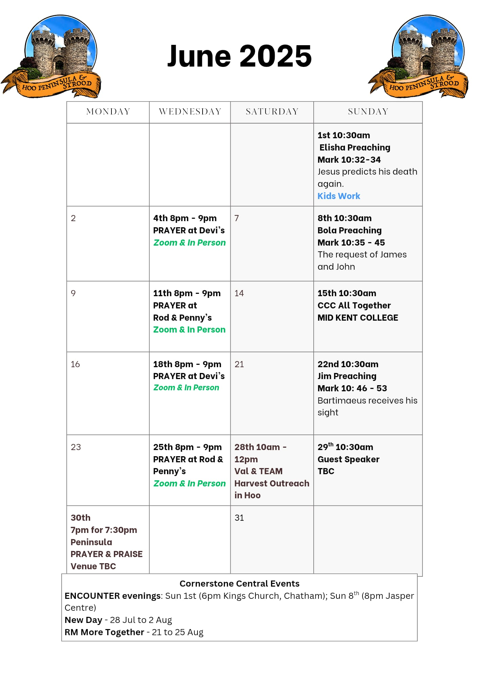

Slide 48


Slide 49


Slide 50

Grow Group 1
On YOUR MARK!

Slide 51
Leaders
Leaderss
Phil & Kim
Maria (Mia) Warren
Matthew Harrison
Richard & Elisha Acheampong
Phil & Kim
Maria (Mia) Warren
Matthew Harrison
Richard & Elisa Acheampong

Slide 52
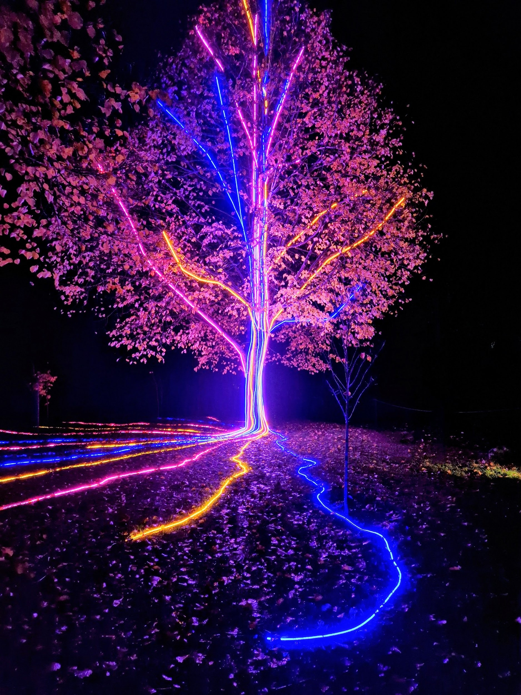
Storm Walker
Storm Walker
Symbolising, trust in Jesus Christ through life's storms.
Mark 4:35-41

Slide 53
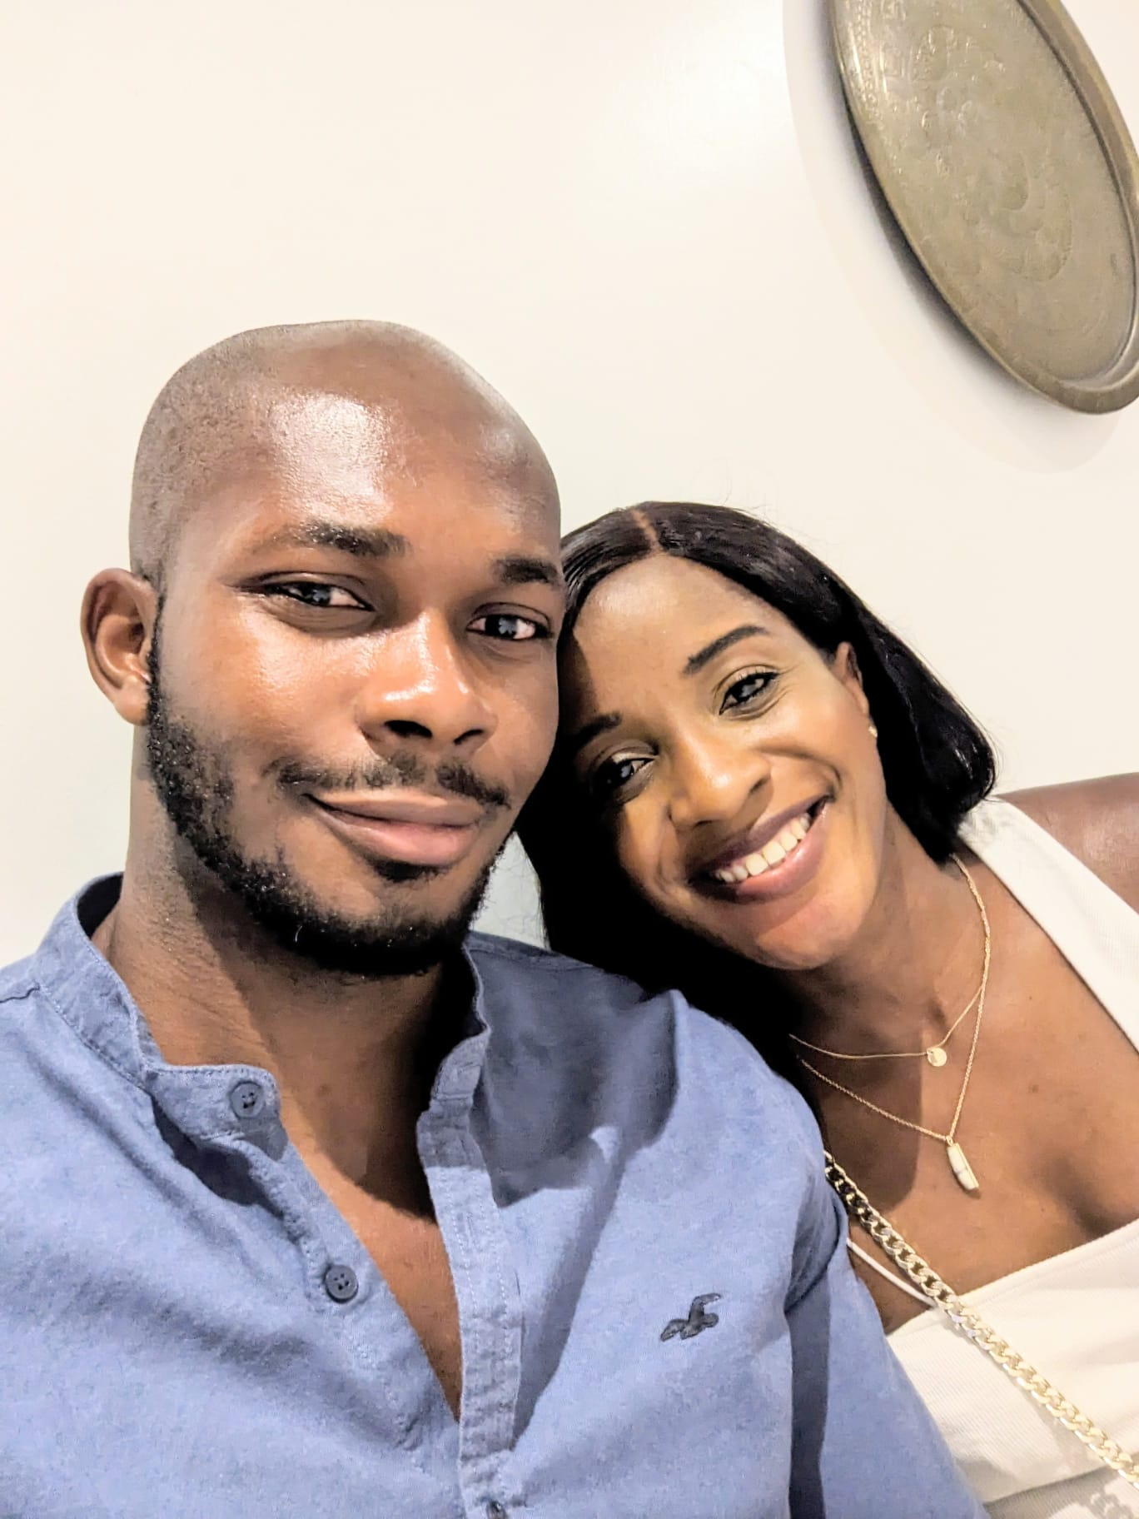

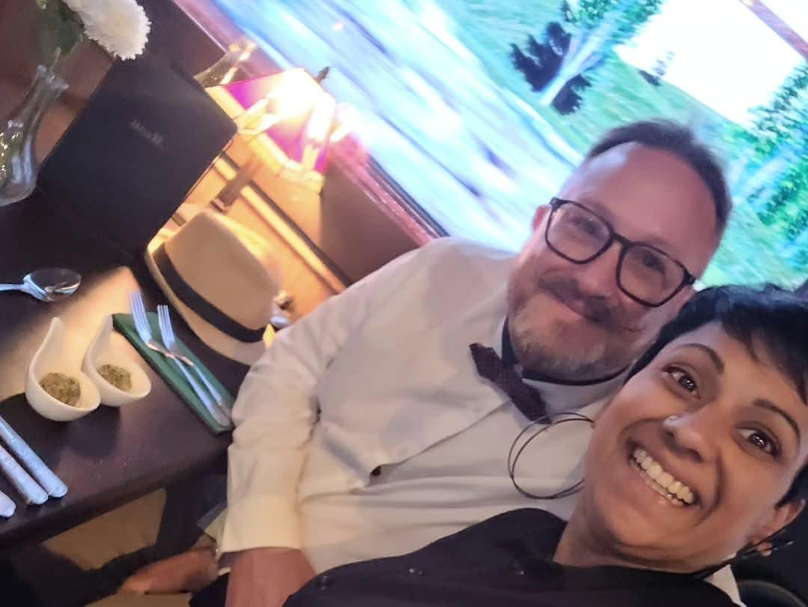
Group Leaders
Micheal and Mwamba
Wilfred and Parveen
Hannah

Slide 54


Slide 55


Slide 56


Slide 57
2 Corinthians 14 May the grace of the Lord Jesus Christ, and the love of God, and the fellowship of the Holy Spirit be with you all
Surely goodness and mercy shall follow me all the days of my life, and I shall dwell in the house of the Lord forever.

